Slide 1

A Data Mining Approach for Heart Disease Prediction and Pattern Extraction

Slide 2
PRESENTERS INFO
Name | ID
1. Apurba Bhowal | 22-46706-1
2. Md. Mostafijur Rahman | 22-47161-1
3. Ahsanul Haque Joar | 22-47183-1
Supervised by Mohaimen Bin Noor

Slide 3
INTRODUCTION
Heart failure is a condition in which the heart is unable to pump enough blood to meet the body’s needs.
The causes of heart failure can be divided into two categories :
First related to the heart’s structure, such as a previous heart attack.
Second related to the heart’s function, such as high blood pressure.
Symptoms of heart failure can include shortness of breath, fatigue, and swelling in the legs and ankles.

Slide 4
PROMBLEM STATEMENT
Several data mining algorithms have been utilized for heart disease prediction, each demonstrating strengths and limitations.
Logistic Regression: Simple and interpretable, but struggles with non-linear data.
Decision Trees: Easy to understand, prone to overfitting.
SVM & Neural Networks: High accuracy, but resource-intensive and less interpretable.
Random Forest & XGBoost: Accurate, but computationally complex with longer training times.

Slide 5
Objective
The objective of this study is to use a tuned Random Forest classifier with 10-fold cross-validation based on features such as age, blood pressure, heart rate, and biochemical markers, ensuring high accuracy and reliability.

Slide 6

METHODOLOGY

Slide 7
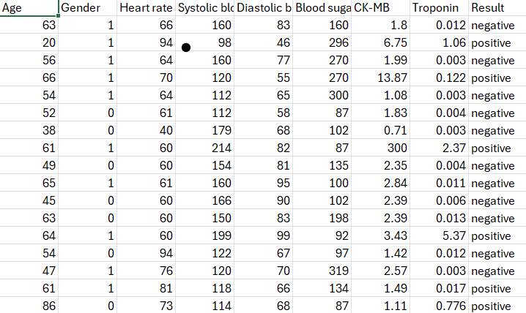
DATASET DESCRIPTION
The dataset used for our Data Mining model was sourced from Kaggle and contains 1319 records with various health-related attributes

Slide 8
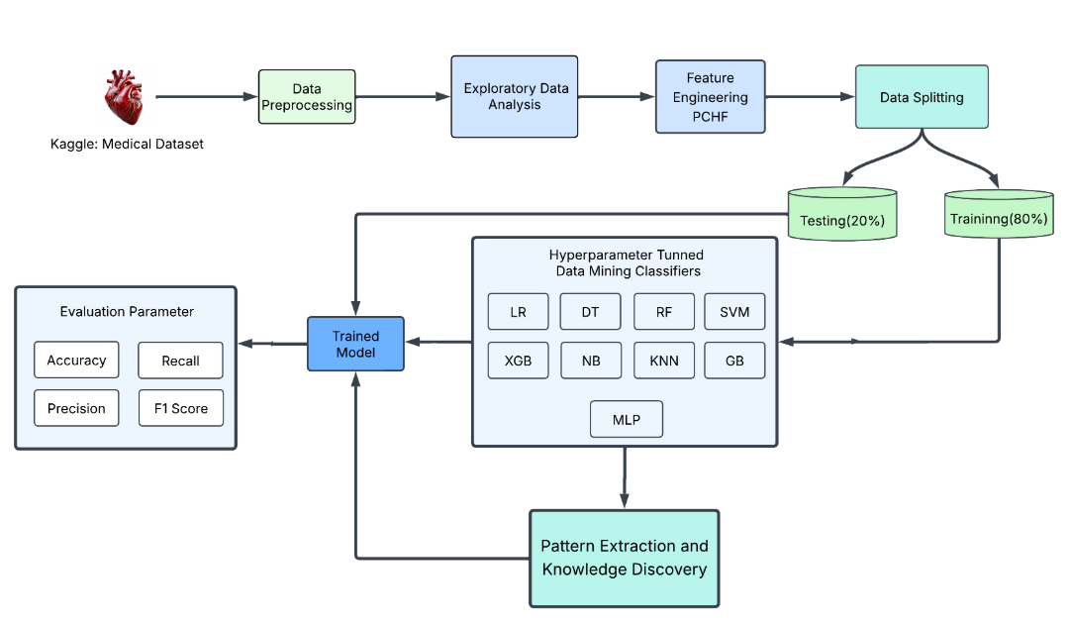
Workflow Diagram of Heart Disease Prediction Model

Slide 9
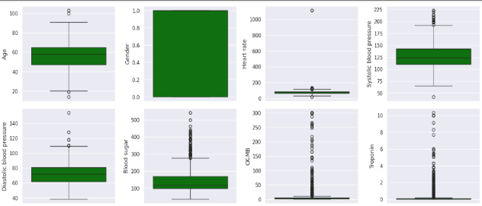
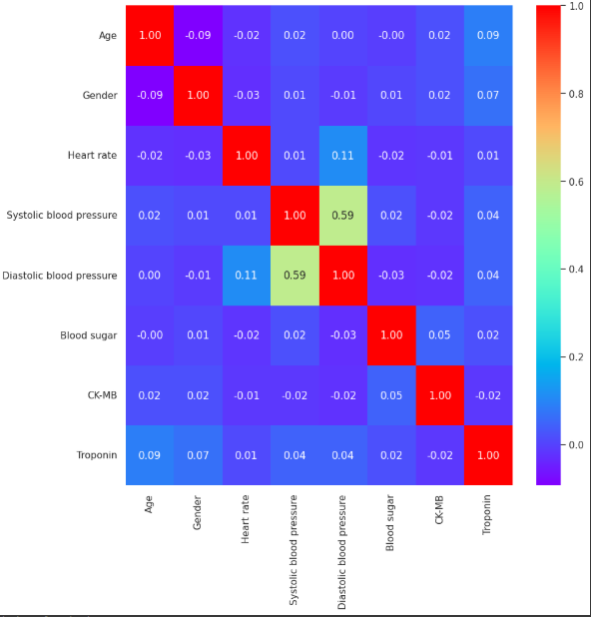
Box Plot & Correlation Heatmap
As the figure shows Blood sugar and troponin have the highest number of outliers. The rest of the attributes are clustered towards the median value.
Correlation Heatmap: Variables are largely independent, indicating that each provides distinct clinical information for patient assessment.

Slide 10

RESULTS & FINDINGS

Slide 11
Logistic Regression, SVC, Random Forest, XGBoost (no cross-validation or tuning).
79.92%
61.74%
LOGISTIC REGRESSION
SVC
98.48%
98.11%
RANDOM FOREST
XG BOOST

Slide 12
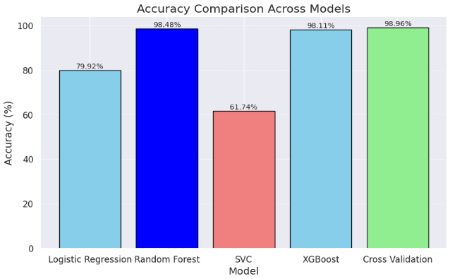
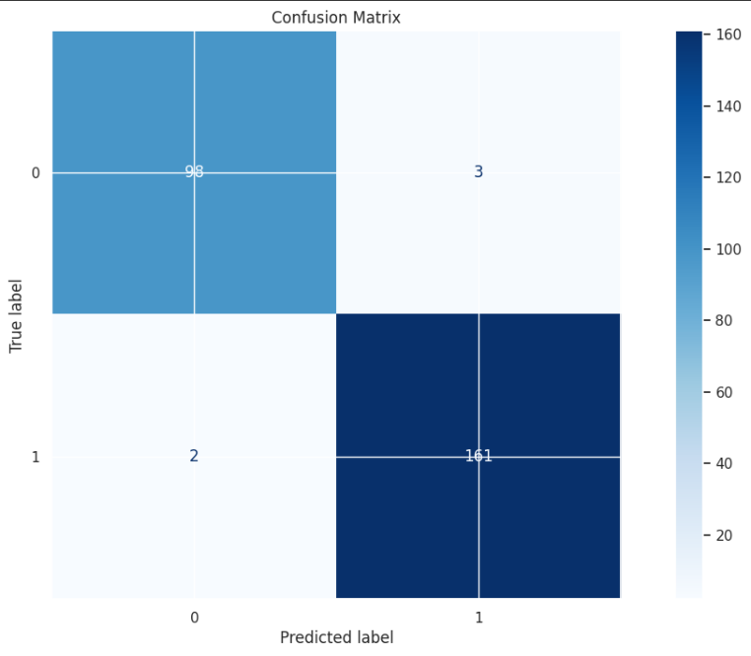
Model evaluation After Applying Technique

Slide 13
CONCLUSION

Slide 14
CONCLUSION
Four data mining techniques—Logistic Regression, Support Vector Classifier (SVC), Random Forest, and XGBoost—were implemented and evaluated.
Performance Enhancement: Random Forest tuned with GridSearchCV and validated with 10-fold cross-validation, achieving the highest accuracy and reliability.
Main Findings: Ensemble methods with advanced validation techniques delivered robust predictions.
Limitations: Model depended on dataset quality and lacked external data for validation.

Slide 15
FUTURE DIRECTIONS
Incorporate External Validation: Test the model on external datasets from diverse populations to ensure its generalizability and robustness across various demographics.
Real-Time Data Integration: Explore the integration of real-time patient data from wearable devices and electronic health records to enhance prediction accuracy and relevance.
Advanced Feature Engineering: Investigate the inclusion of additional clinical and genetic biomarkers to capture more complex relationships influencing heart disease.

Slide 16
REFERENCES
[1] M. Gjoreski, M. Simjanoska, A. Gradišek, A. Peterlin, M. Gams, and G. Poglajen, ‘‘Chronic heart failure detection from heart sounds using a stack of machine-learning classifiers,’’ in Proc. Int. Conf. Intell. Environ ments (IE), Aug. 2017, pp. 14– 19.
[2]G.SavareseandL.H.Lund,‘‘Globalpublichealthburdenofhe artfailure,’’ Cardiac Failure Rev., vol. 3, no. 1, p. 7, 2017.
[3] E. J. Benjamin et al., ‘‘Heart disease and stroke statistics— 2019 update: A report from the American heart association,’’ Circulation, vol. 139, no. 10, pp. e56–e528, 2019.
[4] J. Chen, L. Wang, and X. Zhang, "Logistic regression analysis for disease prediction,“
[5] H. Li, Y. Huang, and Q. Zhao, "Evaluating decision trees for clinical predictions: Challenges and solutions," Journal of Clinical Computing, vol. 12, no. 3, pp. 120–135, 2018.
[6] Y. Tan, M. Liu, and X. Luo, "A comparative study of SVM and neural networks for disease prediction," IEEE Transactions on Biomedical Engineering, vol. 67, no. 6, pp. 1524–1535, 2020.
[7] SCIRP, “Heart Disease Detection by Using Machine Learning Algorithms and a Real-Time Cardiovascular Health Monitoring System.” [Online]. Available: https://www.scirp.org/journal/paperinformation?paperid=88650. [Accessed: 07-Jan-2025].
[8] Nature, “A Proposed Technique for Predicting Heart Disease Using Machine Learning Algorithms and an Explainable AI Method.” [Online]. Available: https://www.nature.com/articles/s41598-024-74656-2. [Accessed: 07-Jan-2025].

Slide 17
REFERENCES
[9] S. M. Lundberg and S. Lee, "A unified approach to interpreting model predictions," Advances in Neural Information Processing Systems, vol. 30, pp. 4765–4774, 2017.
[10] A. Qayyum, J. Qadir, M. Bilal, and A. Al-Fuqaha, ‘‘Secure and robust machine learning for healthcare: A survey,’’ IEEE Rev. Biomed. Eng., vol. 14, pp. 156–180, 2021
[11] "HEART ATTACK DATASET ANALYSIS," Kaggle, 2023. [Online]. Available: https://www.kaggle.com/code/cardata/heart-attack-dataset-analysis/input . [Accessed: Jan. 7, 2025].
[12] J. Smith, K. Wang, and L. Liu, "Data splitting techniques in machine learning," Journal of Data Science and Analytics, vol. 15, no. 3, pp. 112-124, 2022.
[13] M. Gupta and R. Sharma, "Preprocessing techniques for medical data: Handling missing values and normalization," Medical Data Engineering, vol. 19, no. 6, pp. 98-110, 2021.
[14] P. Johnson, T. Lee, and D. Chen, "Imbalance handling in heart disease prediction models," Journal of Machine Learning in Healthcare, vol. 8, no. 2, pp. 75-84, 2020.
[15] L. Zhang and M. Liu, "Logistic regression in medical data classification," International Journal of Applied Statistics, vol. 11, no. 4, pp. 55-68, 2019.

Slide 18

THANKS!
Do you have any questions?

